Slide 1
Designing resilient applications for cloud
Mihai Tataran
General Manager @Avaelgo
Microsoft Regional Director and Azure MVP

Slide 2
Agenda
What is resilience?
Process to achieve resilience
Defining your resilience requirements
Designing for resilience
Resilience strategies
Resilient deployment
Monitoring and diagnostics

Slide 3
What is Resilience?
Resilience is a system’s ability to recover from failures and continue to function. It’s not only about avoiding failures but also involves responding to failures in a way that minimizes downtime or data loss. Because failures can occur at various levels, it’s important to have protection for all types based on your application availability requirements

Slide 4
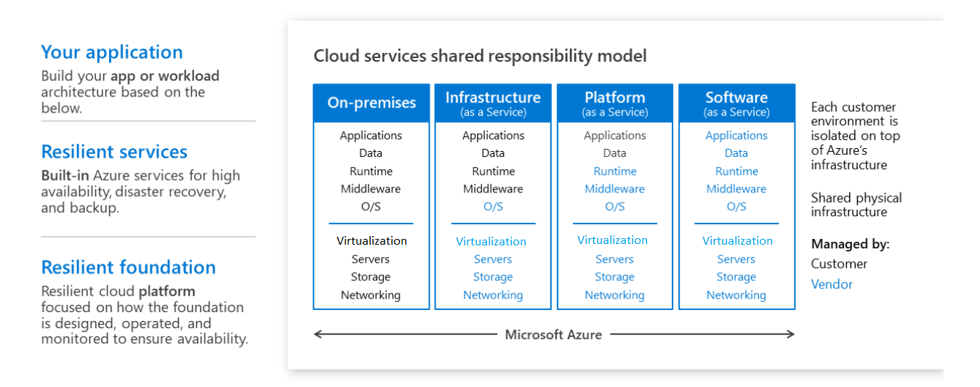
In the cloud - Building systems that survive failure is a Shared Responsibility
Notes:
Azure invests in platform resilience and complements those investments with the abovementioned offerings to ensure uptime for customers. Being resilient in the event of any failure, however, is a shared responsibility. Who’s responsible for what, in terms of resilience, depends on the cloud service model that’s being used—IaaS, PaaS, or SaaS
In the traditional on-premises model, the entire responsibility of managing—from the hardware for compute, storage, and networking to the application—falls on the customer. That requires planning for various types of failures and knowing how to deal with them on-premises. With IaaS, Azure is responsible for the core infrastructure resilience, which includes storage, networking, and compute. As the model moves from IaaS to PaaS and then to SaaS, the customer is responsible for less and the cloud service provider is responsible for more.

Slide 5
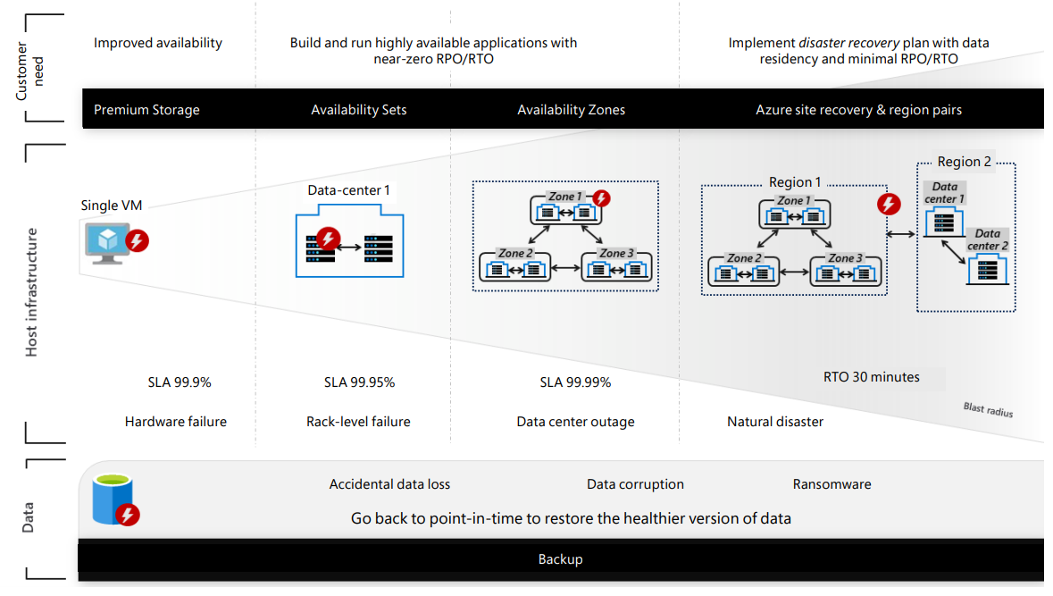
Azure Resilient Services
Notes:
To help protect against the consequences of such failures, Azure provides a comprehensive set of built-in resilience services that customers can easily enable and control based on individual business needs. Whether it’s a single hardware node failure, a rack level failure, a datacenter outage, or a large-scale regional outage, Azure offers solutions

Slide 6
Azure Resilient Services
Availability Sets | Ensure that the VMs deployed on Azure are distributed across multiple isolated hardware nodes in a cluster
Availability Zones | protect customers’ applications and data from datacenter failures across multiple physical locations within a region
Azure Load Balancer | distributes inbound traffic according to rules and health probes
Azure Traffic Manager | enables optimal traffic distribution to services across global Azure regions, while providing high availability (HA) and responsiveness
Azure Site Recovery | replicates workloads from a primary VM to a secondary failover location—allowing for business continuity and disaster recovery needs
Azure Backup | serves as a general backup solution for cloud and on-premises workflows that run on VMs or physical servers
Geo-replication for Azure SQL Database | allows an application to perform quick disaster recovery of individual databases in case of a regional disaster or large-scale outage
Locally redundant storage (LRS) | provides object durability by replicating customer data to a storage scale unit
Zone redundant storage (ZRS) | replicates customer data synchronously across three storage clusters in a single region
Geo-redundant storage (GRS) | provides object durability over a given year by replicating customer data to a secondary region that’s hundreds of miles away from the primary region

Slide 7
Process to design Resilient Applications
Define
Resiliency Requirements based on business needs
Design
Design app for resilience, start with best practices and tried out patterns, evaluate and detect failure points
Implement
Strategy to detect and recover from failure
Test
Simulate faults and trigger forced failovers
Deploy
Build reliability in the deployment process
Monitor
Monitor for failure, gauge the health and respond to incidents
Respond
Incidents may require manual interventions

Slide 8
Define Resiliency Requirements

Slide 9
Metrics to measure resilience
Recovery time objective (RTO)
Recovery point objective (RPO)
Mean time to recover (MTTR)
Mean time between failures (MTBF)
Service-level agreement (SLA)
Notes:
Metrics to measure resilience
The following metrics are used to measure resilience:
Recovery time objective (RTO) is the maximum acceptable time that an application can be unavailable after an incident.
Recovery point objective (RPO) is the maximum duration for which data loss can occur during a disaster.
Mean time to recover (MTTR) is the average time that it takes to restore a component after a failure.
Mean time between failures (MTBF) is the runtime that a component can reasonably expect to last between outages.
The service-level agreement (SLA) in Azure describes our commitments regarding uptime and connectivity. If the SLA for a service is 99.9 percent, customers can expect the service to be available 99.9 percent of the time. Dealing with multiple services that have different agreements adds complexity. In this case, it’s necessary to calculate a composite SLA

Slide 10
Understand Application Availability requirements
How much downtime is acceptable?
How much will potential downtime cost the business?
How much money and time can the business realistically invest in making the application highly available?
Notes:
It’s also important to define what it means for the application to be available. For example, is the application considered down if someone can submit an order, but the system can’t process it within the normal timeframe?
Also, consider the probability of an outage occurring and whether a mitigation strategy is cost-effective.
Resilience planning begins with business requirements. The following are some approaches to help in thinking about resilience in those terms

Slide 11
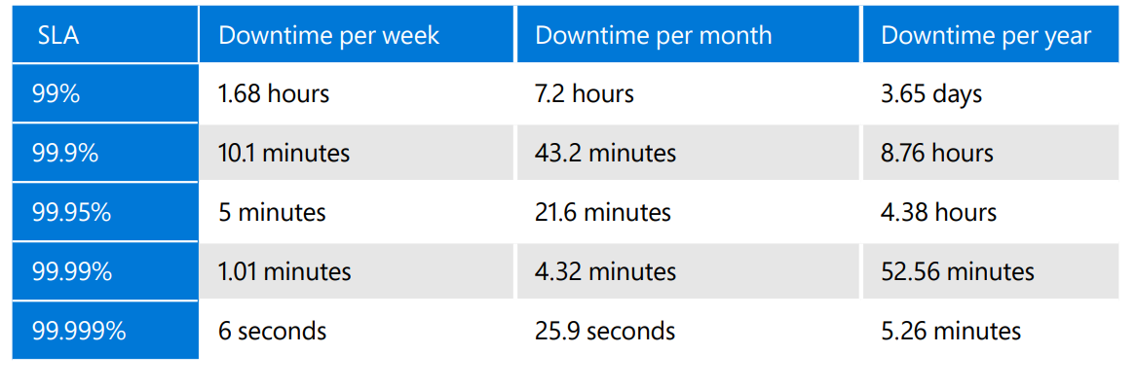
Understand SLAs SLA describes commitment regarding uptime and connectivity

Slide 12
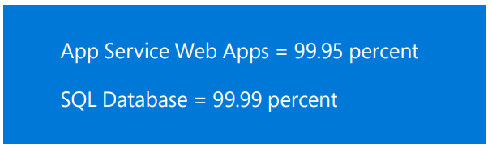
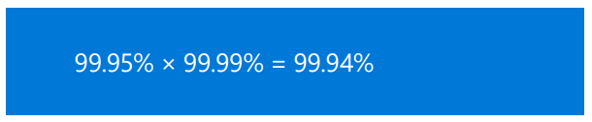
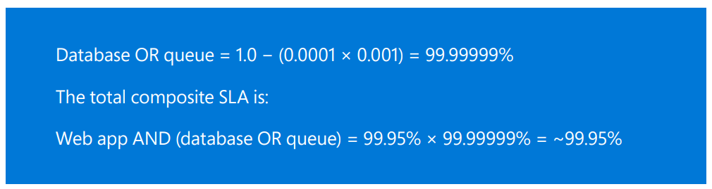
Composite SLAs
Application Uses following Services
Application with multiple services that have different SLAs adds complexity
Need to calculate a composite SLA
Composite SLA can be improved by creating independent fallback paths for services likely to fail
Composite SLA for the Application
Composite SLA for the Application using Queue as fallback
Notes:
Consider an App Service web app that writes to Azure SQL Database. At the time of this writing, these Azure services have the following SLAs: • App Service Web Apps = 99.95% • SQL Database = 99.99% Composite SLAs What is the maximum downtime you would expect for this application? If either service fails, the whole application fails. In general, the probability of each service failing is independent, so the composite SLA for this application is 99.95% × 99.99% = 99.94%. That’s lower than the individual SLAs, which isn’t surprising, because an application that relies on multiple services has more potential failure points

Slide 13
Identify application resiliency requirements
Decompose Application by Workload
For example, an e-commerce app might include the following workloads: Browse and search a product catalog, Create and track orders, View recommendations.
Each workload may have different requirements for availability, scalability, data consistency, and disaster recovery
Categorizing applications into different tiers
Each tier define the exact availability SLA, RPO, and RTO requirements
Categorization may vary from customer to customer or industry to industry
Differentiate by Customer type (SaaS)
Different Customers with different Non-Functional requirements, including resiliency (and scaling, perf…)
Might consider accommodating those differences by having different deployments for different Customer types
Notes:
Decompose by workload Many cloud solutions consist of multiple application workloads. The term workload in this context means a discrete capability or computing task, which can be logically separated from other tasks in terms of business logic and data storage requirements. For example, an e-commerce app might include the following workloads: Browse and search a product catalog. Create and track orders. View recommendations. These workloads might have different requirements for availability, scalability, data consistency, and disaster recovery. This means business decisions are required to balance cost versus risk.
Categorizing applications into different tiers is a common strategy. Tier zero and tier one applications are made up of those applications that should experience very minimal data loss and downtime.
The RTO/RPO for this tier needs to be zero or as close to nil as possible. Tier two applications consist of applications for which it’s acceptable to lose minimal amounts of data with RTO and RPO of the order of a few minutes. With tier three and tier four applications, downtime can affect internal operations for a few hours. While this is inconvenient, it doesn’t pose a huge risk to the business. The categorization of applications and the exact availability SLA, RPO, and RTO requirements vary from industry to industry, and from customer to customer. For example, an e-commerce website is tier zero or tier one for a retail company where the only sales channel is through the website. For a retail company where brick and mortar stores are the primary sales channel, the point of sales (POS) application is tier zero or tier one. Thus, it’s important to categorize the application inventory into multiple tiers based on the organization’s business needs and resilience requirements.

Slide 14
Design for Resilience

Slide 15
Types of Application failures
Hardware failure
Datacenter failure
Regional failure
Transient failure
Dependency service failure
Accidental data deletion or corruption
Application deployment failure
Notes:
Hardware failure A failure of any hardware component including computer, network, or storage hardware.
Datacenter failure An entire datacenter is impacted by issues such as a power grid outage.
Regional failure This includes any natural disaster-like event that impacts multiple datacenters in a region, causing the entire region to go down.
Transient failure Requests between various components fail intermittently. End user requests will fail when this isn’t handled properly.
Dependency service failure This occurs when any service on which the application is dependent is not functioning correctly. Heavy load A sudden spike in incoming requests prevents the application from servicing requests.
Accidental data deletion or corruption Customers mistakenly delete critical data or data has been corrupted due to unforeseen reasons.
Application deployment failure A failure that takes place when updating production application deployments

Slide 16
Failure Mode Analysis
Process to identify possible points of failure and define how the application will respond to those failures

Slide 17
Steps for conducting a FMA
Identify all system components and include external dependencies
For each component identify potential failures that could occur – there may be more than one
Rate each failure mode according to its overall risk
For each failure mode, determine how the application will detect, respond, and recover
Consider trade-offs in terms of cost and application complexity
Notes:
The steps for conducting an FMA:
Identify all system components and include external dependencies, such as identity providers, third-party services, and so on.
For each component, identify potential failures that could occur, keeping in mind that a single component may have more than one failure mode. For example, consider read failures and write failures separately, because the impact and possible mitigations of each will be different.
Rate each failure mode according to its overall risk. Consider these factors: What’s the likelihood of the failure? Exact numbers aren’t necessary because the purpose is to help rank the priority. What’s the impact on the application, in terms of availability, data loss, monetary cost, and business disruption?
For each failure mode, determine how the application will detect, respond, and recover. Consider trade-offs in terms of cost and application complexity

Slide 18
Implement Resiliency Strategies

Slide 19
Resiliency Strategies for different Failure Types
Hardware failure | Build redundancy into the application by deploying components across different fault domains. For example, ensure that Azure VMs are placed in different racks by using Availability Sets
Datacenter failure | Build redundancy into the application with fault isolation zones across datacenters. For example, ensure that Azure VMs are placed in different fault-isolated datacenters by using Azure Availability Zones
Regional failure | Replicate the data and components into another region so that applications can be quickly recovered. For example, use Azure Site Recovery to replicate Azure VMs to another Azure region
Transient failure | Retry transient failures. For many Azure services, the client software development kit (SDK) implements automatic retries in a way that’s transparent to the caller
Dependency service failure | Degrade gracefully if a service fails without a failover path, providing an acceptable user experience
Heavy load | Load balance across instances to handle spikes in usage. For example, put two or more Azure VMs behind a load balancer to distribute traffic to all VMs
Accidental data deletion or corruption | Back up data so it can be restored if there’s any deletion or corruption. For example, use Azure Backup to periodically back up your Azure VMs
Application deployment failure | Automate deployments with a rollback plan
Notes:
Hardware failure
Build redundancy into the application by deploying components across different fault domains. For example, ensure that Azure VMs are placed in different racks by using Availability Sets.
Datacenter failure
Build redundancy into the application with fault isolation zones across datacenters. For example, ensure that Azure VMs are placed in different fault-isolated datacenters by using Azure Availability Zones.
Regional failure
Replicate the data and components into another region so that applications can be quickly recovered. For example, use Azure Site Recovery to replicate Azure VMs to another Azure region.
Transient failure
Retry transient failures. For many Azure services, the client software development kit (SDK) implements automatic retries in a way that’s transparent to the caller.
Dependency service failure
Degrade gracefully if a service fails without a failover path, providing an acceptable user experience.
Heavy load
Load balance across instances to handle spikes in usage. For example, put two or more Azure VMs behind a load balancer to distribute traffic to all VMs.
Accidental data deletion or corruption
Back up data so it can be restored if there’s any deletion or corruption. For example, use Azure Backup to periodically back up your Azure VMs.
Application deployment failure
Automate deployments with a rollback plan

Slide 20


Example of resilient architecture options
Cloud Infrastructure Architect | Cloud Infrastructure Ops
Premium Storage
Availability Sets
Availability Zones
Azure Site Recovery / Region Pairs
Region 2
Region 1
Data center 1
Single VM
Data center
Zone 1
Zone 1
Infrastructure
(applications and data)
Rack 1
Rack 2
Data center 2
Zone 2
Zone 3
Zone 2
Zone 3
Hardware failure
Rack level failure
Datacenter outage
Natural Disaster
Accidental data loss
Data corruption
Ransomware
Data
(stateful)
Restore to a certain point in time with healthier data
Backup
Learn more about org roles, best practices, and Azure capabilities at the 4/19 briefing: Achieving Resilience in the Cloud
Notes:
Just in 2018, 28% of customers have experienced data loss and 40% have experienced an unplanned outage. Just 2% of organizations recovered from their latest incident in under an hour. Azure’s overall availability has been trending up constantly and is now at over 99.999% reliability across the fleet. Microsoft’s cloud technology provides innovative features such as memory-preserving host updates and live migration. But more importantly, Azure provides a comprehensive set of built-in resilient services to recover from hardware failures, natural disasters and data loss. As a result, we see more customers enable their mission-critical workloads on Azure.
So we have seen how Resilience is not about avoiding any failure but bouncing back from one. Let’s look at some typical failures that may lead to a downtime for your application –
This trapezium shows the degree of impact that a failure can potentially cause. So while, a power or a network outage may impact a datacenter of a multiple data centers in a zone; something more catastrophic like a flood or earthquake can take down the entire region. All these failures primarily impact your infrastructure (which comprises of both applications and the data).
There’s one thing that is common across though, no matter what your deployment is (you can be running the entire set up in a single region vs spread across zones), you will most likely have data; data which is stateful; data which you would need to go back to.
The failures impacting this data look like these. And to draw a parallel, these too in some sense have varying degree of impact of these failures on the data; while accidental deletion may lead to losing a file or folder; a rogue admin can wipe off not only your data but also your backups.
Thus, we need to build resilience against all these failure and the azure services can help us achieve just that.
Opt for Premium storage that allows for 99.5% availability in case of a single VM deployment.
Up your Resilience game with High Availability structures; deploy your architecture in Availability sets or AZs to get SLA up to 99.99%. HA should be preferred for your mission critical apps which have very stringent RPO and RTO requirements (almost real time).
Go one step head to further isolate your VMs by making used of paired regions in azure. The recently previewed feature for storage account failover when configured for GRS also is a subset of this solution.
But none of them still covers you for data failures; and that’s because all of these deployments are almost constantly syncing data across; so if any data corruption happens and I need to go back in time to say a couple of days, I need to have backed-up that version. Hence, we have Backup.

Slide 21
Design Patterns for Resiliency
Pattern | Summary
Bulkhead | Isolate elements of an application into pools so that if one fails, the others will continue to function.
Circuit Breaker | Handle faults that might take a variable amount of time to fix when connecting to a remote service or resource.
Compensating Transaction | Undo the work performed by a series of steps, which together define an eventually consistent operation.
Health Endpoint Monitoring | Implement functional checks in an application that external tools can access through exposed endpoints at regular intervals.
Leader Election | Coordinate the actions performed by a collection of collaborating task instances in a distributed application by electing one instance as the leader that assumes responsibility for managing the other instances.
Queue-Based Load Leveling | Use a queue that acts as a buffer between a task and a service that it invokes in order to smooth intermittent heavy loads.
Retry | Enable an application to handle anticipated, temporary failures when it tries to connect to a service or network resource by transparently retrying an operation that's previously failed.
Scheduler Agent Supervisor | Coordinate a set of actions across a distributed set of services and other remote resources.
Notes:
https://docs.microsoft.com/en-us/azure/architecture/framework/resiliency/reliability-patterns

Slide 22
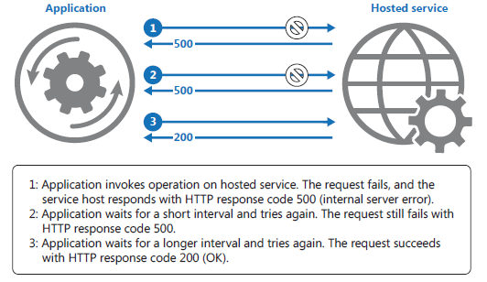
Retry pattern
Handle anticipated temporary failures
PROBLEM: transient errors – remote or shared resources
SOLUTION: retry with the assumption that the transient fault will disappear

Slide 23
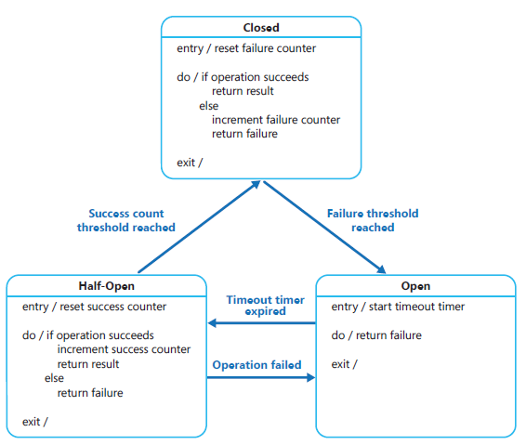
Circuit breaker
Handle faults that may take a variable amount of time to rectify, and which don’t seem to be transient
PROBLEM: operations that access remote or shared resources might fail due to transient faults
SOLUTION: continue execution without waiting for the fault to be rectified. Also detect if the fault has been resolved.

Slide 24
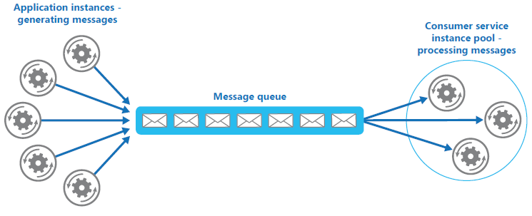
Competing consumers / Queue-based load leveling
Multiple concurrent consumers process messages
Publisher / subscriber
Scale components independently
E.g.: Online Shop

Slide 25
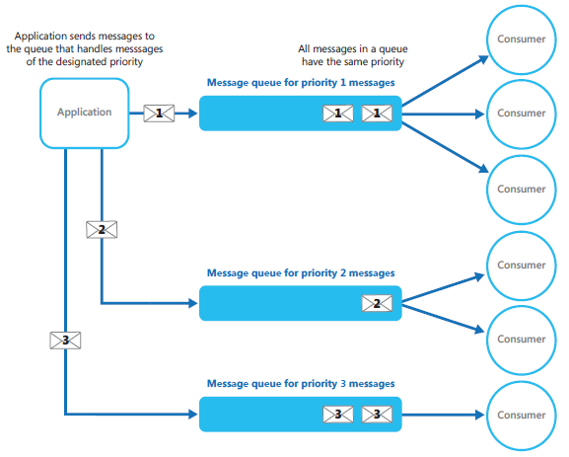
Priority Queue
Multiple concurrent consumers process messages
Publisher / subscriber
BUT multi-tenant solution with different service levels

Slide 26
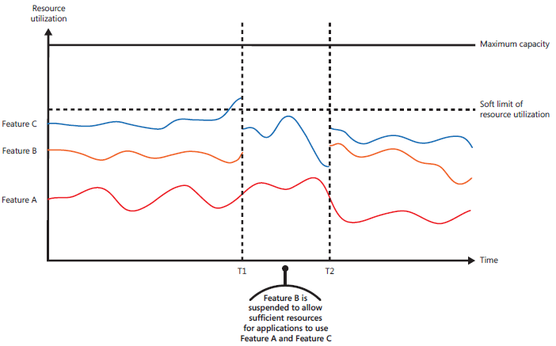
Throttling
Control resources’ consumption
Still meet SLA but limit functionalities when facing a huge demand
An alternative to Autoscaling

Slide 27
Testing for Resiliency

Slide 28
Testing for Resiliency
Resilience can’t be tested in the same way as application functionality by running unit tests etc
Need to test how the end-to-end workload performs under failure conditions that only occur intermittently
Testing is an iterative process
Test the application, measure the outcome, analyze and address any failures that result, and repeat the process

Slide 29
Testing for Resiliency
Fault injection testing
Test the resilience of the system during failures, either by triggering actual failures or by simulating them. Some common failure scenarios to test:
Shut down VM instances.
Crash processes.
Expire certificates.
Change access keys.
Shut down the DNS service on domain controllers.
Limit available system resources, such as RAM or number of threads.
Unmount disks.
Redeploy a VM
Measure the recovery times and verify that business requirements are met
Test combinations of failure modes
Load Testing
Crucial for identifying failures that only happen under load
Disaster recovery drills
Disaster recovery plan must also be tested periodically to ensure that the recovery plan works properly when it matters most
Notes:
Testing for Resiliency
Generally, you can’t test resilience in the same way that you test application functionality (by running unit tests and so on). Instead, you must test how the end-to-end workload performs under failure conditions which only occur intermittently. Testing is an iterative process. Test the application, measure the outcome, analyse and address any failures that result, and repeat the process
Fault injection testing. Test the resilience of the system during failures, either by triggering actual failures or by simulating them. Here are some common failure scenarios to test: • Shut down VM instances. • Crash processes. • Expire certificates. • Change access keys. • Shut down the DNS service on domain controllers. • Limit available system resources, such as RAM or number of threads. • Unmount disks. • Redeploy a VM. Measure the recovery times and verify that your business requirements are met. Test combinations of failure modes as well. Make sure that failures don’t cascade and are handled in an isolated way. This is another reason why it’s important to analyse possible failure points during the design phase. The results of that analysis should be input into your test plan.
Load testing. Load testing is crucial for identifying failures that only happen under load, such as the backend database being overwhelmed or service throttling. Test for peak load, using production data or synthetic data that’s as close to production data as possible. The goal is to observe how the application behaves under realworld conditions.
Disaster recovery drills. It’s not enough to have a good disaster recovery plan in place. It must also be tested periodically to ensure that the recovery plan works properly when it matters most. For Azure virtual machines, use Azure Site Recovery to replicate and perform disaster recovery drills—all without impacting production applications or ongoing replication

Slide 30
Deploy using a reliable process

Slide 31
Resilient deployment
Manual deployments are prone to error
Recommended to have an automated, idempotent deployment process that you can run on demand and re-run if something fails.
After an application is deployed to production, updates present a potential source of errors
Deployment includes provisioning Azure resources, deploying application code, and applying configuration settings
Notes:
Once an application is deployed to production, updates are a possible source of errors. In the worst case, a bad update can cause downtime. To avoid this, the deployment process must be predictable and repeatable. Deployment includes provisioning Azure resources, deploying application code and applying configuration settings. An update may involve all three or a subset. The crucial point is that manual deployments are prone to error. Therefore, it’s recommended to have an automated, idempotent process that you can run on demand and re-run if something fails.
• Use Resource Manager templates to automate provisioning of Azure resources.
• Use Azure Automation Desired State Configuration (DSC) to configure VMs.
• Use an automated deployment process for application code

Slide 32
Resilient deployment concepts
Infrastructure as code
The practice of using code to provision and configure infrastructure.
Declarative approach or Imperative approach (or a combination of both)
Immutable infrastructure
The principle that you shouldn’t modify infrastructure after it’s deployed to production
When ad hoc changes have been applied, it’s hard to know exactly what changed, and hard to reason about the system
Notes:
Infrastructure as code is the practice of using code to provision and configure infrastructure. Infrastructure as code may use a declarative approach or an imperative approach (or a combination of both). Resource Manager templates are an example of a declarative approach. PowerShell scripts are an example of an imperative approach.
Immutable infrastructure is the principle that you shouldn’t modify infrastructure after it’s deployed to production. Otherwise, you can get into a state where ad hoc changes have been applied, so it’s hard to know exactly what changed, and hard to reason about the system

Slide 33
Application updates
Blue-green deployment
A technique whereby an update is deployed into a production environment separately from the live application
After validating the deployment, switch the traffic routing to the updated version
Canary releases
The update is rolled out to a small percentage of users by routing a portion of the traffic to the new deployment
If there’s a problem, back off and revert to the old deployment
Else incrementally route more traffic to the new version until it’s handling 100 percent of the traffic
Notes:
Blue-green deployment is a technique whereby an update is deployed into a production environment separately from the live application. After validating the deployment, switch the traffic routing to the updated version. For example, Azure App Service enables this with staging slots .
Canary releases are similar to blue-green deployments, but instead of switching all traffic to the updated version, the update is rolled out to a small percentage of users by routing a portion of the traffic to the new deployment. If there’s a problem, back off and revert to the old deployment. Otherwise, incrementally route more traffic to the new version until it’s handling 100 percent of the traffic.
Regardless of which approach is used, ensure the ability to roll back to the last known good deployment in case the new version isn’t functioning. In addition, have a strategy in place to roll back database changes and any other changes to dependent services. If errors occur, the application logs must indicate which version caused the error

Slide 34
Monitor for failure

Slide 35
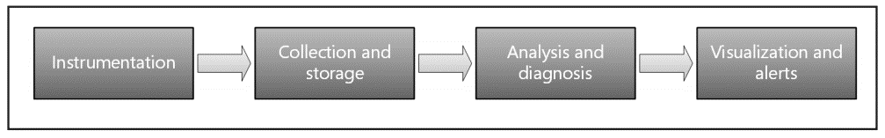
Monitoring and diagnostics
Notes:
Instrumentation. The raw data for monitoring and diagnostics comes from a variety of sources, including application logs, web server logs, OS performance counters, database logs and diagnostics built into the Azure platform. Most Azure services have a diagnostics feature that you can use to determine the cause of problems.
Collection and storage. Raw instrumentation data can be held in various locations and with various formats (e.g., application trace logs, IIS logs, performance counters). These disparate sources are collected, consolidated and put into reliable storage.
Analysis and diagnosis. After the data is consolidated, it can be analysed to troubleshoot issues and provide an overall view of application health.
Visualisation and alerts. In this stage, telemetry data is presented in such a way that an operator can quickly notice problems or trends. Examples include dashboards or email alerts.

Slide 36
Monitoring tips and tricks
Use Azure Log Analytics as a store for logs
Why? Easier to understand what is going on during an incident, using the query language
Azure Diagnostics
Application-level logs
Use Dashboards
Design and implement an Alerting system
Probably using the exact same Resource-level metrics that you monitor
Make sure not to overload the ticketing system
Adapt iteratively. E.g.: after monitoring constantly some metrics, you find out which tend to get over a threshold
Don’t forget to monitor the Azure Audit Logs
Watch Azure Service Health

Slide 37
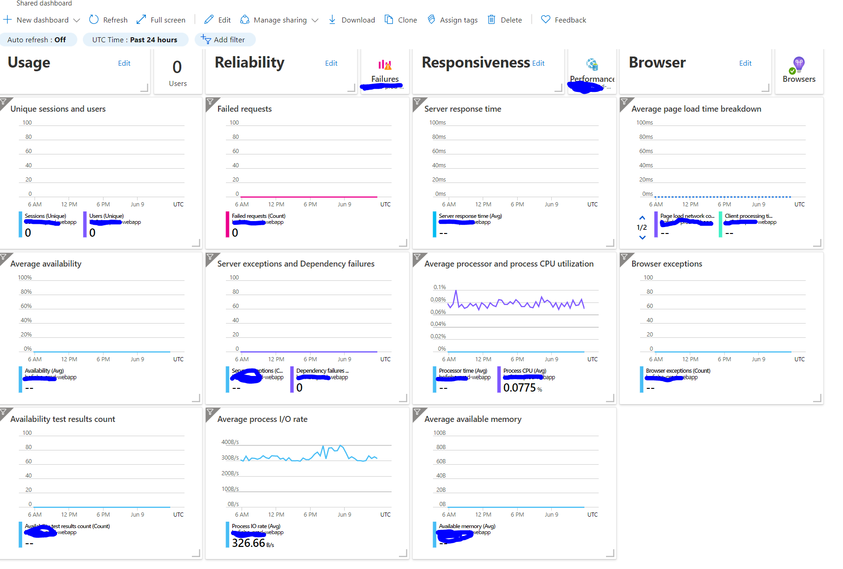
Azure Dashboard for Monitoring
Create a custom Dashboard
Funnel all relevant metrics:
Azure Audit Logs
Azure Diagnostics
App Insights

Slide 38
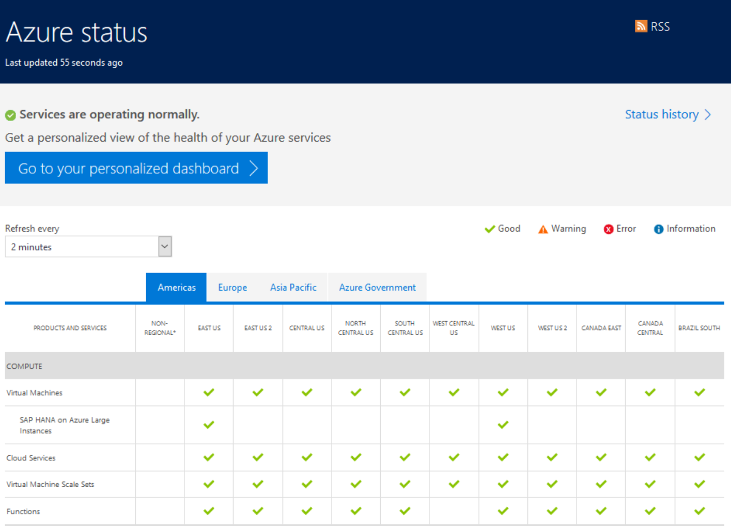
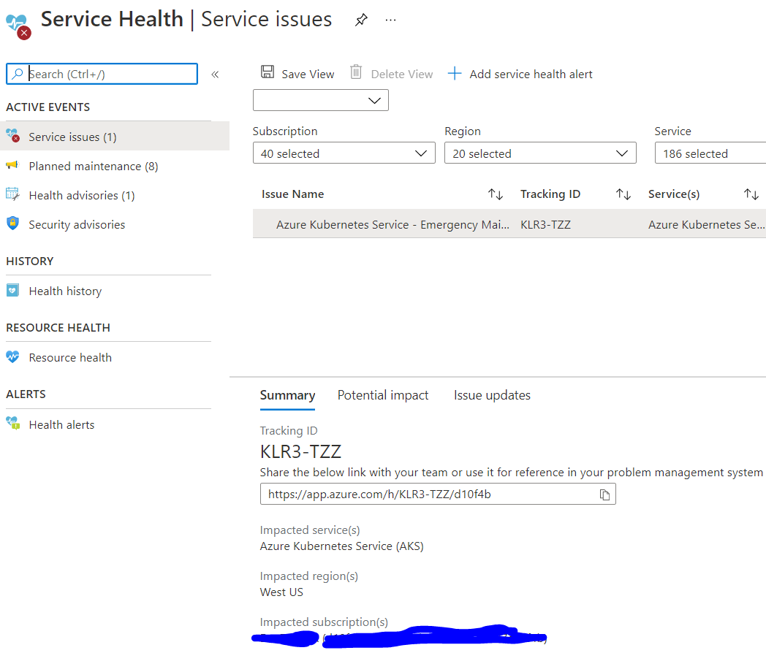
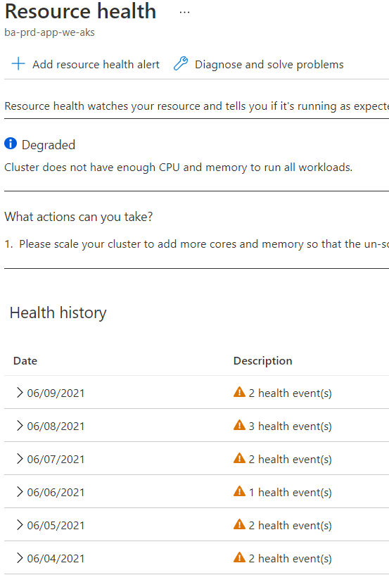
Azure Service Health

Slide 39
Manual Response to failures

Slide 40
Manual failure responses
Alerts
Manual Failover
Operational readiness testing
Data consistency check
Restoring from backup
Notes:
Even with automated recovery strategies, sometimes manual intervention is needed.
Alerts.
Monitor the application for warning signs that may require proactive intervention. For example, if SQL Database or Cosmos DB consistently throttle the application, increase your database capacity or optimize queries. In this example, even though the application might handle the throttling errors transparently, telemetry should still raise an alert so that you can follow up. Microsoft recommends configuring alerts on Azure resource metrics and diagnostics logs against the service limits and quota thresholds and further recommends setting up alerts on metrics, as they are lower latency than diagnostics logs. In addition, Azure is able to provide some out-of-the-box health statuses through resource health, which can help diagnose throttling of Azure services.
Failover.
Configure a disaster recovery strategy for the application. The appropriate strategy will depend on the SLAs. For most scenarios, an active-passive implementation is sufficient. For more information, see Deployment topologies for disaster recovery. Most Azure services allow for either manual or automated failover. For example, in an IaaS application, use Azure Site Recovery for the web and logic tiers and SQL AlwaysOn availability groups for the database tier. Traffic Manager provides automated failover across regions.
Operational readiness testing.
Perform an operational readiness test for both failover to the secondary region and failback to the primary region. Many Azure services support manual failover or test failover for disaster recovery drills. Alternatively, simulate an outage by shutting down or removing services.
Data consistency check.
If a failure occurs in a data store, there may be data inconsistencies when the store becomes available again, especially if the data was replicated. For Azure services that provide cross-regional replication, look at the RTO and RPO to understand the expected data loss in a failure. Review the SLAs for Azure services to understand whether crossregional failover can be initiated manually or if it will be initiated by Microsoft. For some services, Microsoft decides when to perform the failover. Microsoft may prioritize the recovery of data in the primary region, only failing over to a secondary region if data in the primary region is deemed unrecoverable. For example, GRS and Azure Key Vault follow this model
Restoring from backup.
In some scenarios, restoring from backup is only possible within the same region. This is the case for Azure Backup. Other Azure services, such as Azure Cache for Redis, provide geo-replicated backups. The purpose of backups is to protect against accidental deletion or corruption of data by restoring the application to an earlier functional version. Therefore, while backups can serve as a disaster recovery solution in some cases, the inverse isn’t always true. Disaster recovery won’t protect you against accidental deletion or corruption of data

Slide 41
Summary
Resilience leads to higher availability and lower mean time to recover from failures.
Achieving resilience in the cloud requires a different set of techniques from traditional on-premises solutions.
Resilience does not happen by accident. It must be designed and built in from the start.
Resilience touches every part of the application lifecycle, from planning and coding to operations.
Test and monitor.

